Slide 1


Instructor Resources
Chapter 7 Figures
Cover photo: BeautyStock – stock.adobe.com.

Slide 2
Chapter 7
Limitations

Slide 3
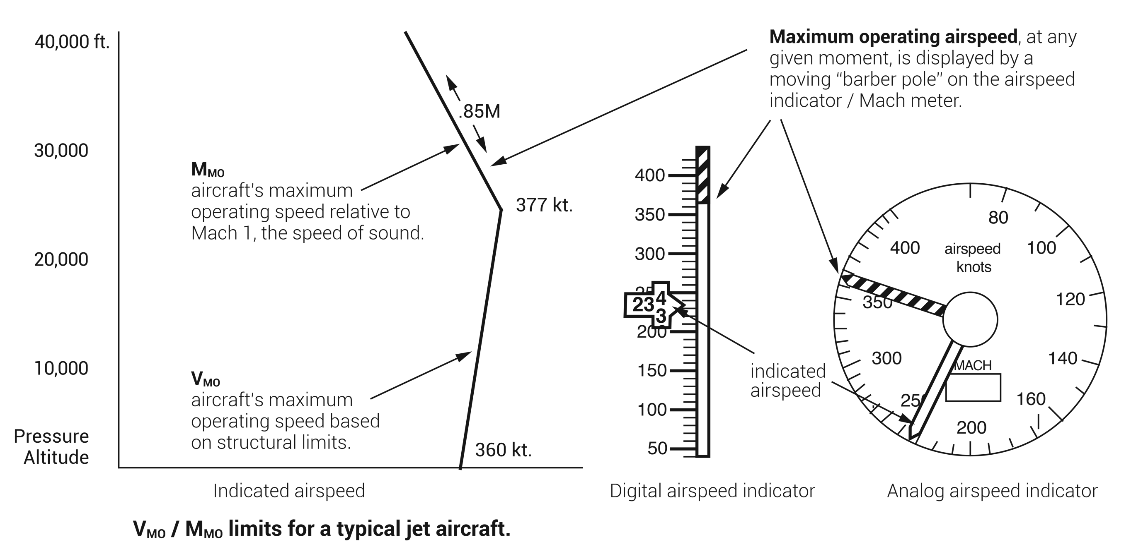
FIGURE 7.1
Maximum operating limit speeds (indicated by the airspeed indicator “barber pole”).

Slide 4
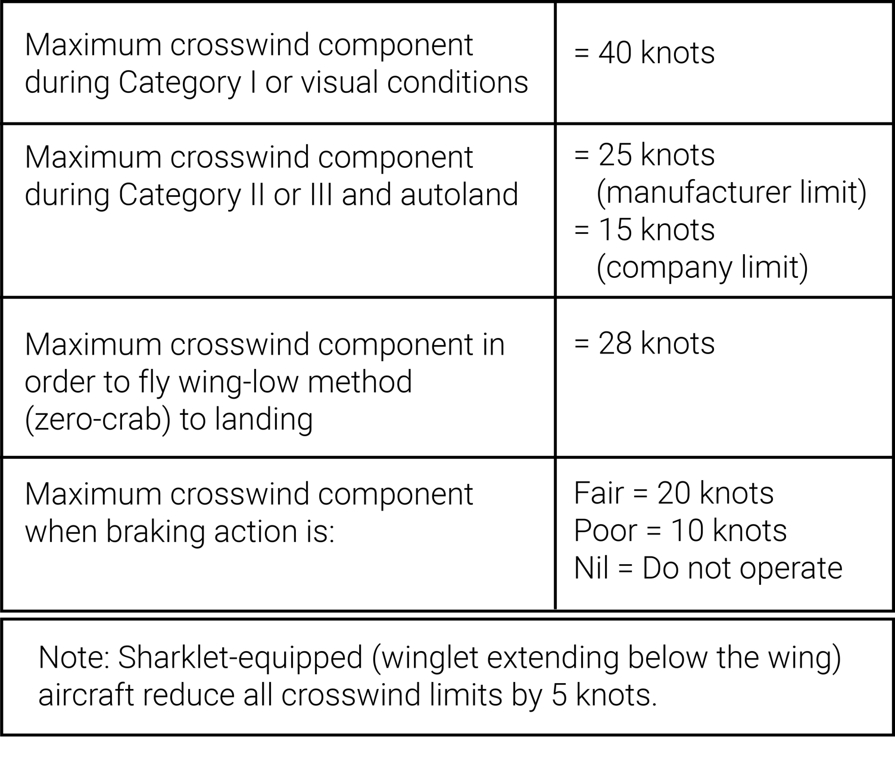
FIGURE 7.2
Typical transport category aircraft crosswind limitations.

Slide 5
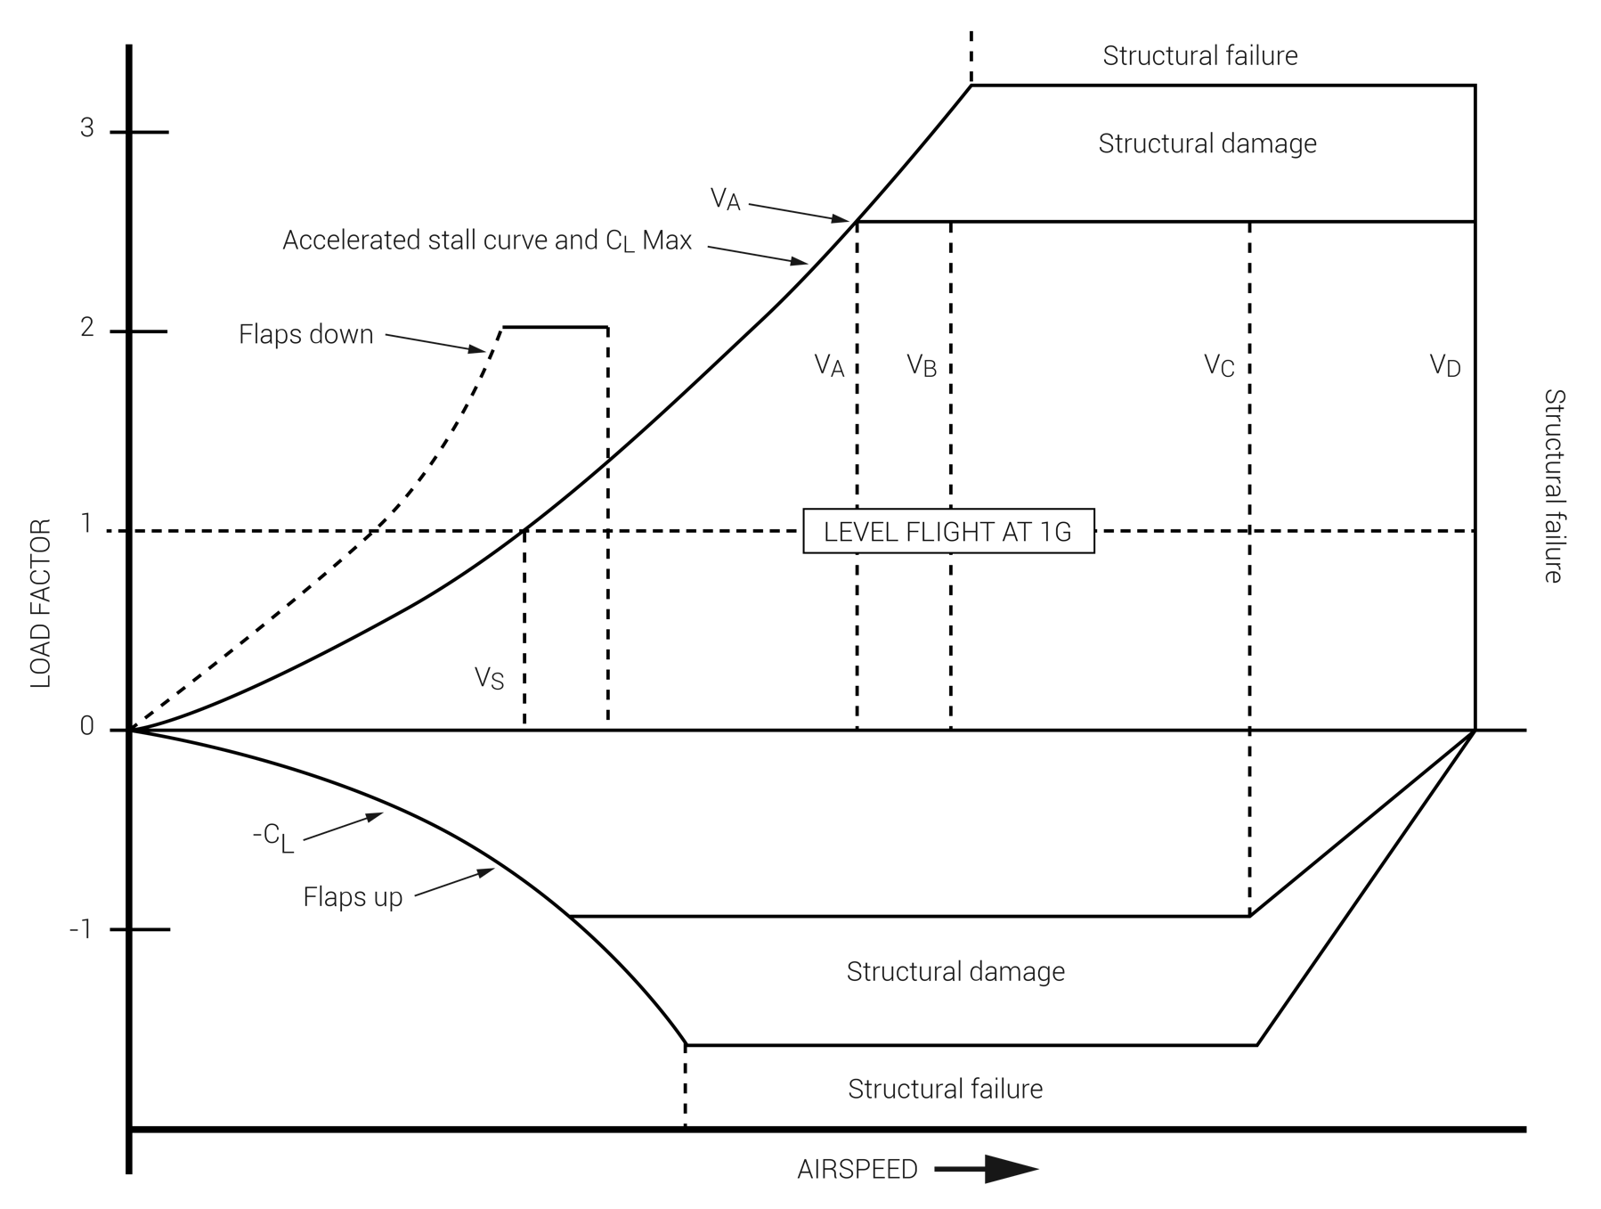
FIGURE 7.3
Flight maneuver envelope.

Slide 6
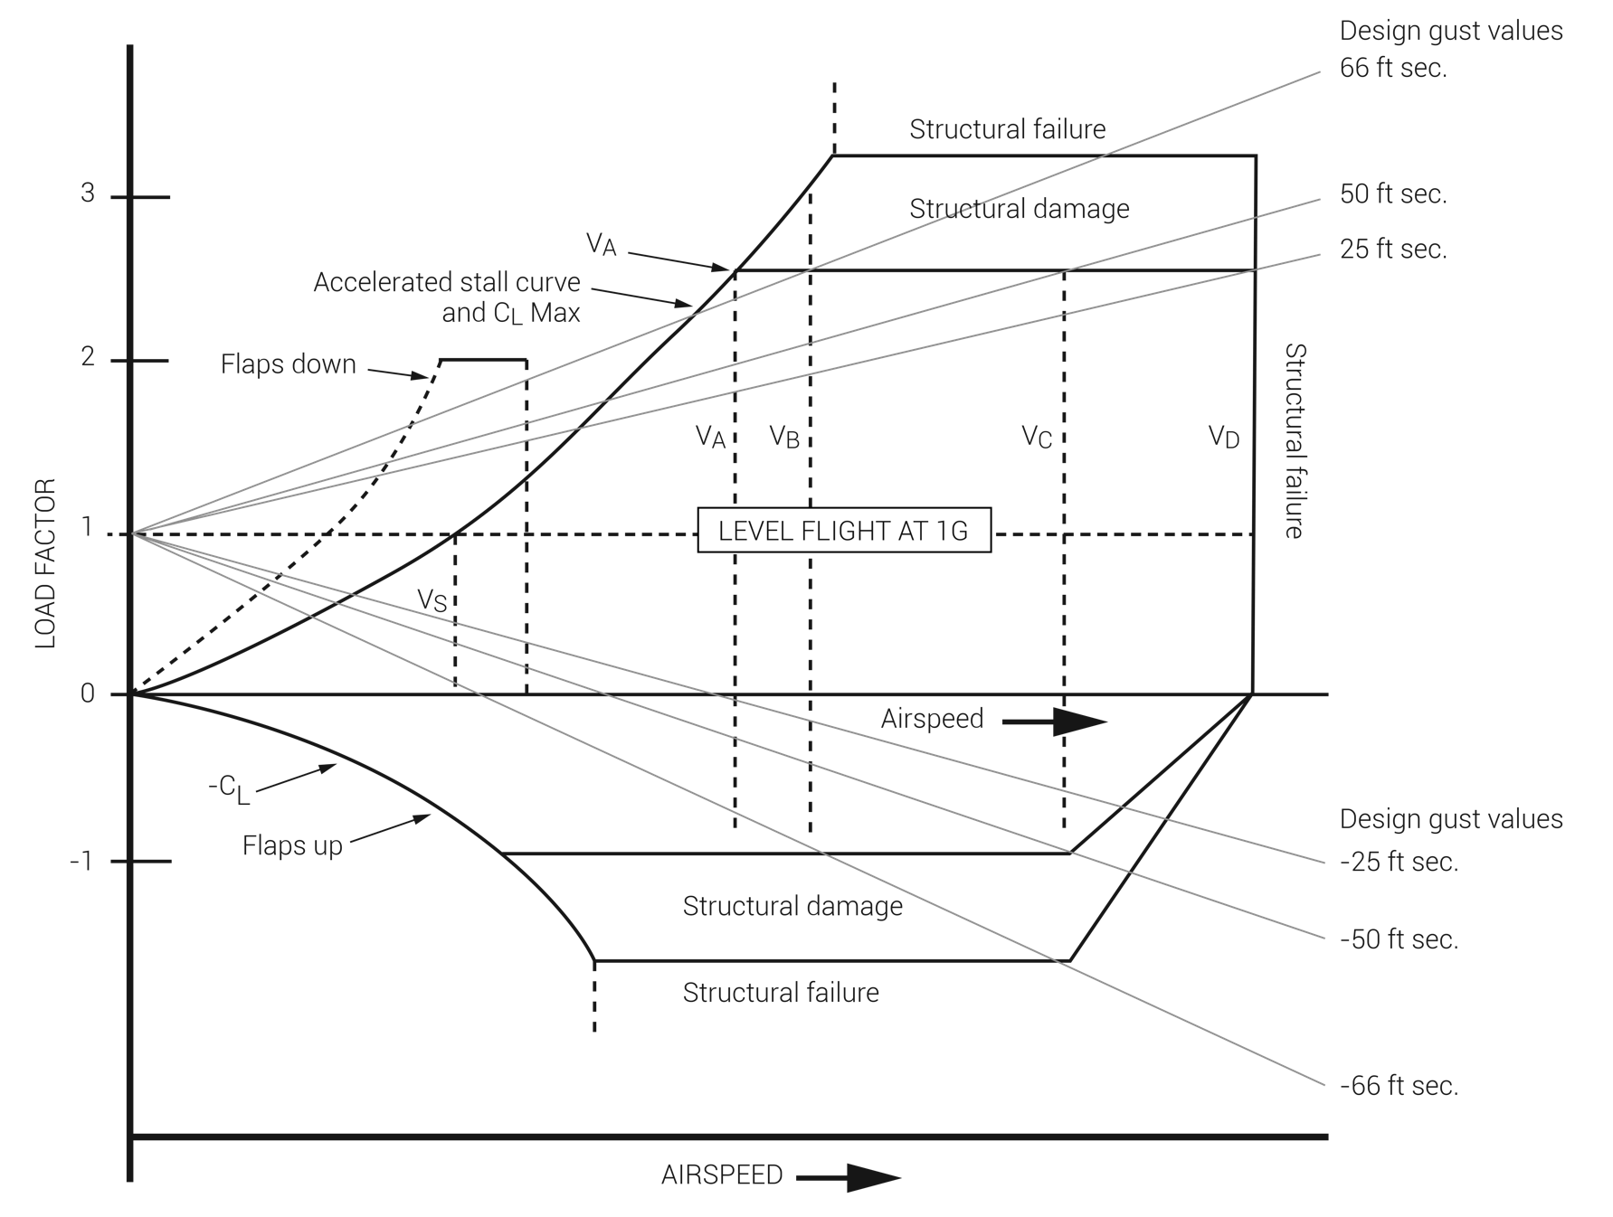
FIGURE 7.4
Flight maneuver envelope with design gust values.

Slide 7
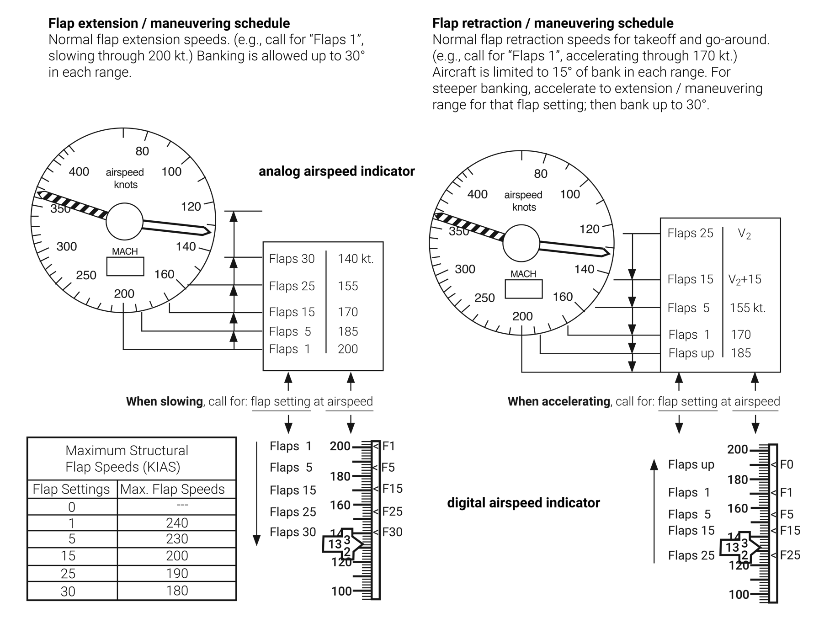
FIGURE 7.5
Flap extension/retraction/maneuvering speeds for a large turbine aircraft.

Slide 8
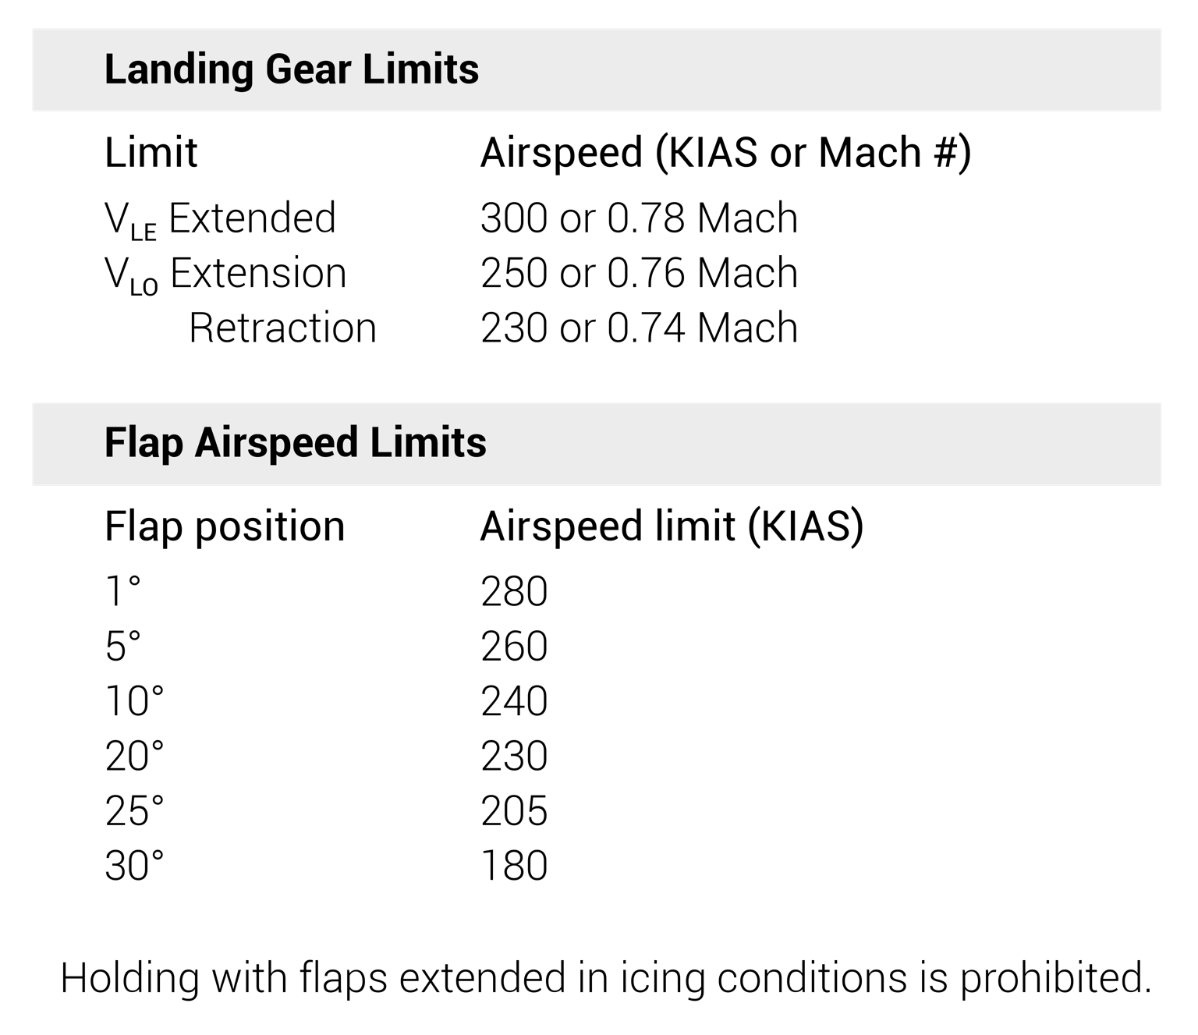
FIGURE 7.6
Typical types of flap and landing gear restrictions (placarded limits).

